Slide 1

User Support
McRae & Dick Case Management System

Slide 2
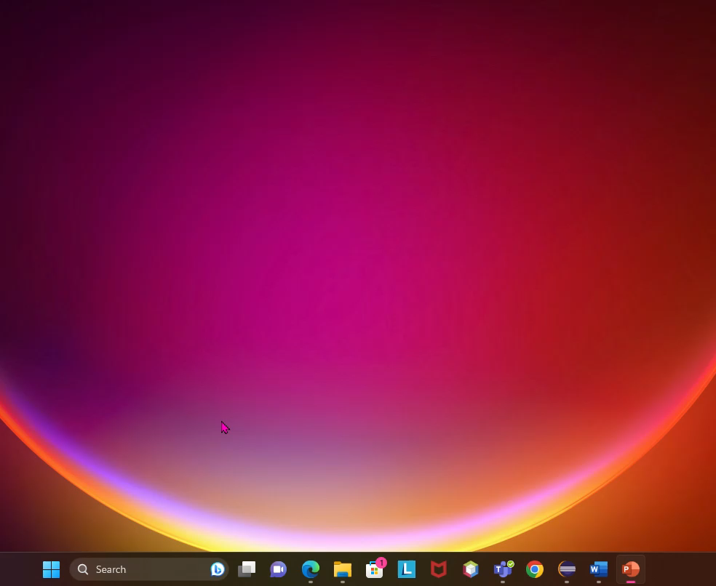
JRE
The clip below shows you how to find out if you already have a Java Runtime Environment. The steps are:
Open a command prompt
Type java –version and press Enter

Slide 3
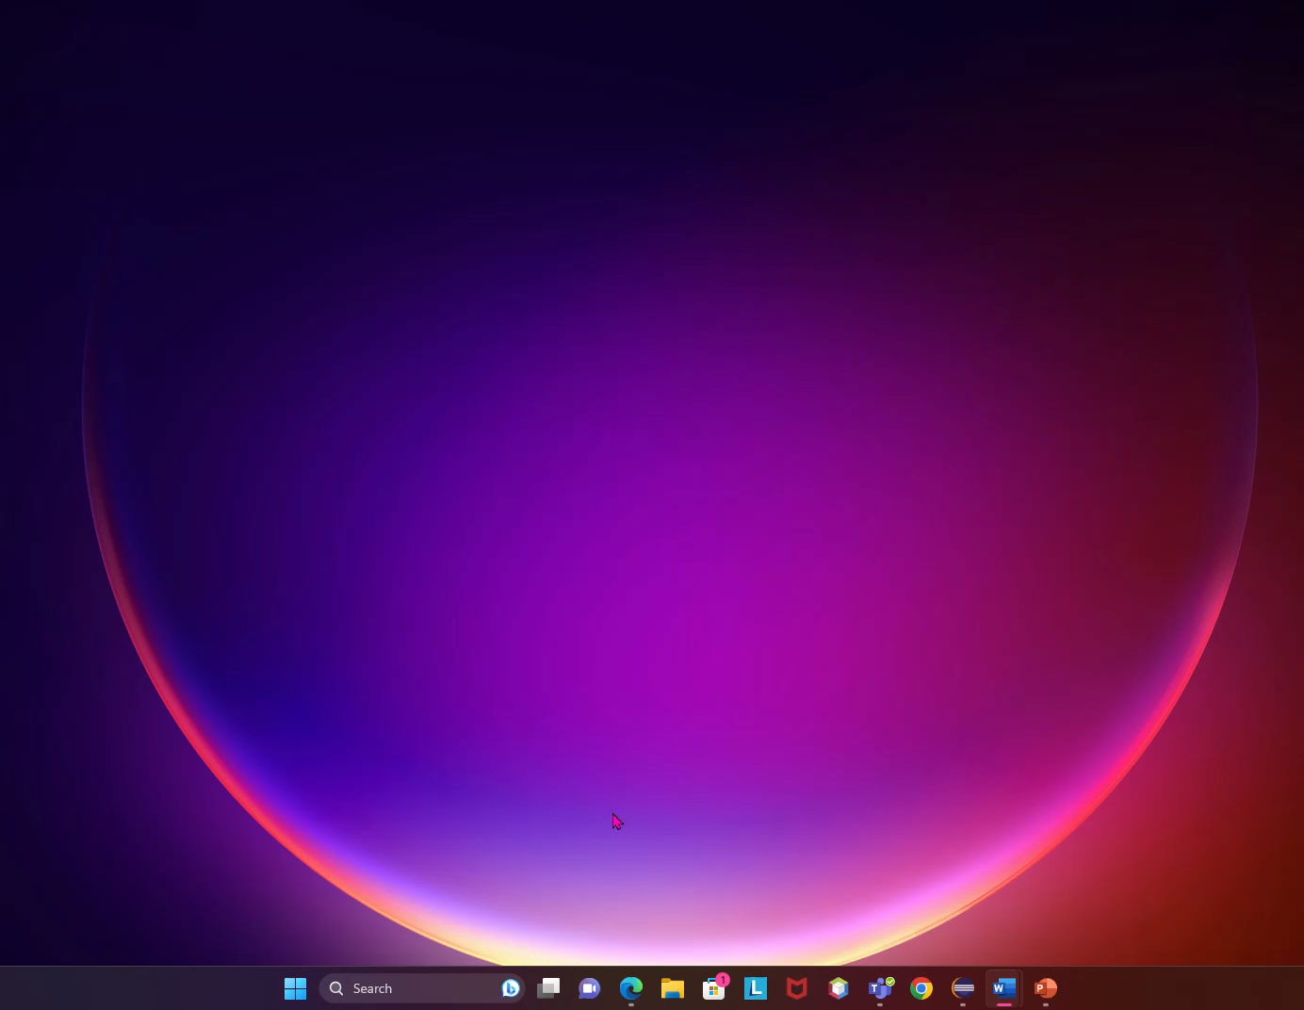
Logging In
The clip below shows you how to log in to your system. You will need your username and password.
Find “User Pack” folder
Double click app
Enter username
Enter password
Press “Sign In”

Slide 4
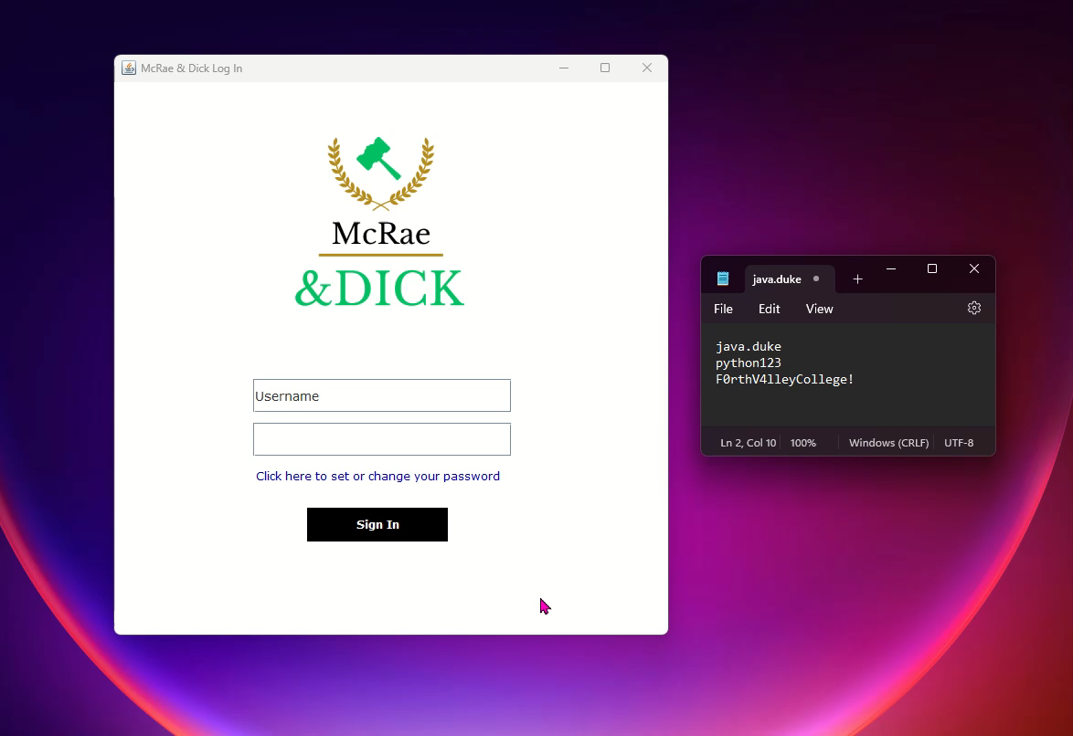
Reset Password
The clip below shows you how to reset your password.
Click link
Enter username
Enter old password
Enter new password
Press “Reset Password”
Log in

Slide 5
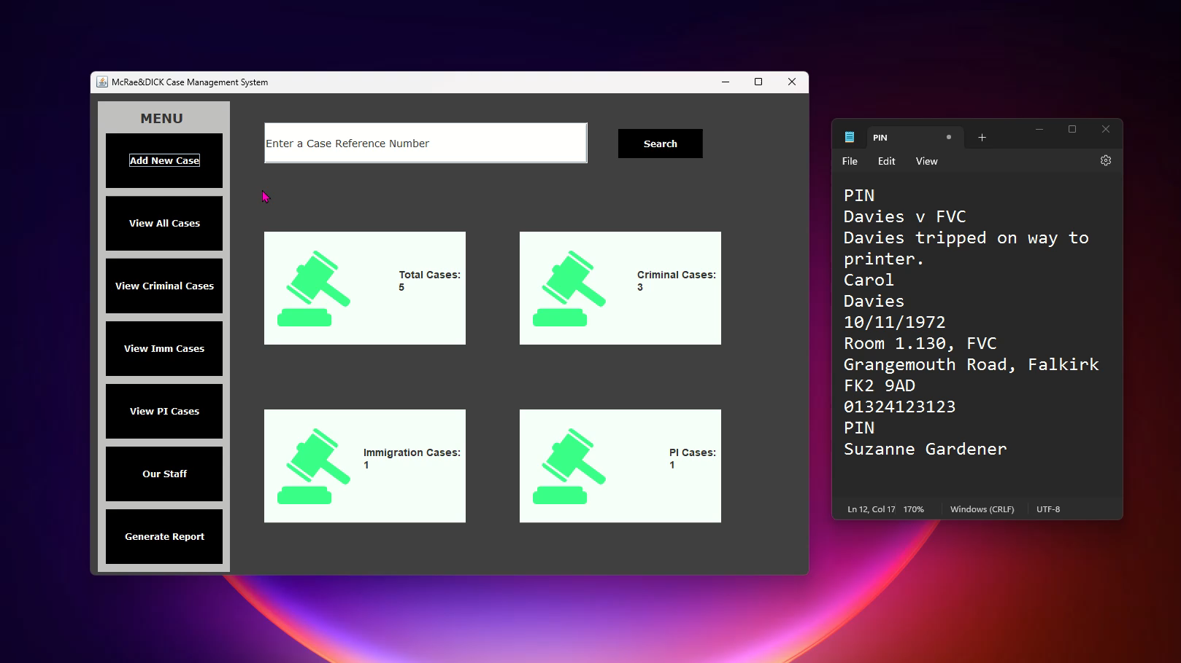
Add a New Case
The clip below shows you how to add a new Case.
Press “Add New Case”
Enter details
Press “Confirm New Case”

Slide 6
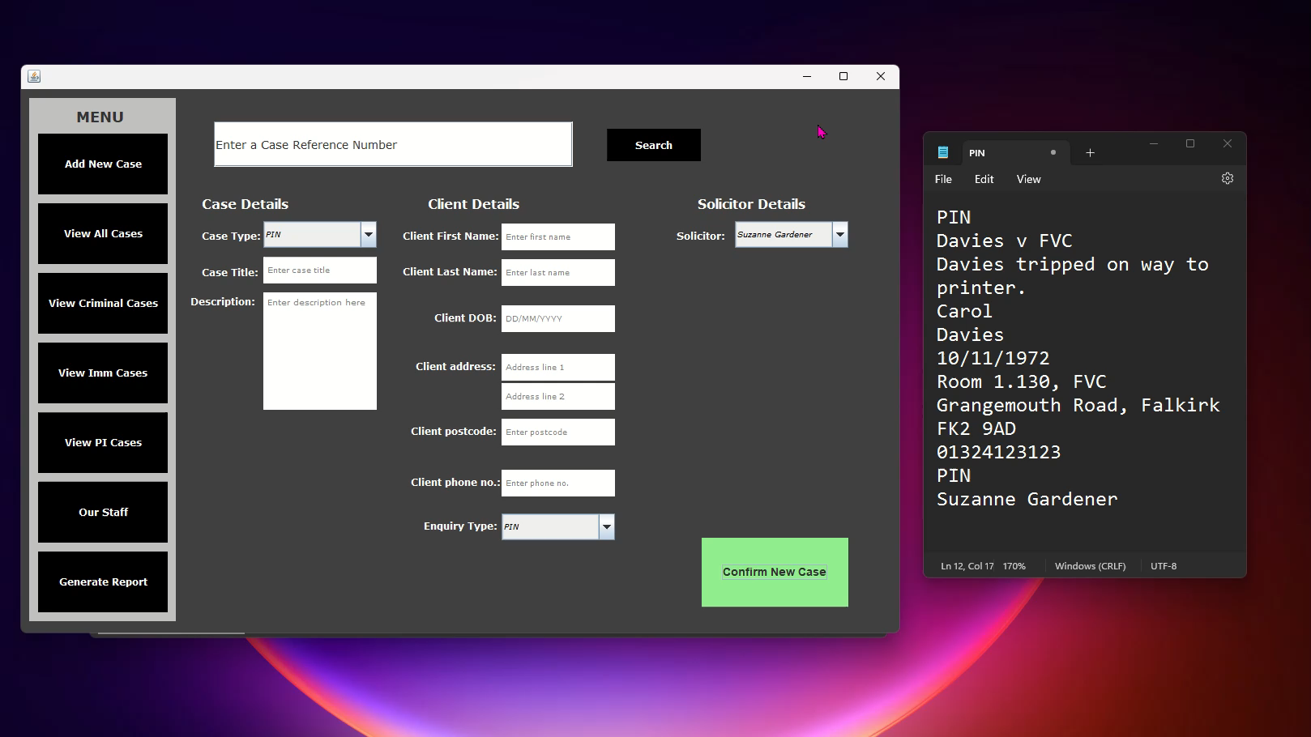
Searching and Viewing All Cases
The clip below shows you how search for a Case and how to view all Cases.

Slide 7
Need Help?
Name: Daria Vekic
Email: dariavekic@hotmail.co.uk
Phone: 07753463113

